Slide 1


COMPSCI 412
Intro. of Computer Organization
Haijian Sun
Email: sunh@uww.edu

Slide 2
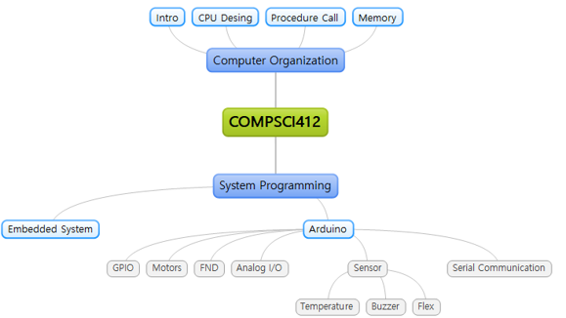
Class Overview

Slide 3

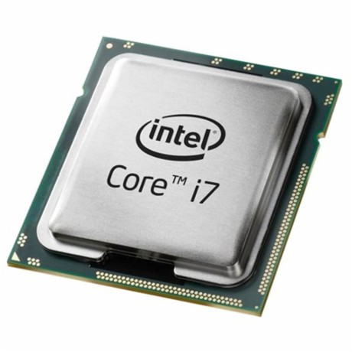
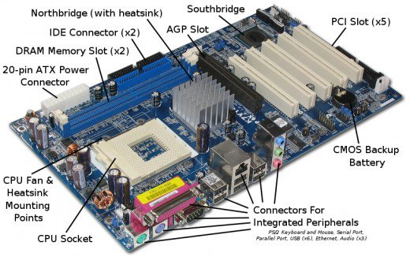
Computer Organization
Computer
Notes:
you may have seen the inside of a computer.

Slide 4
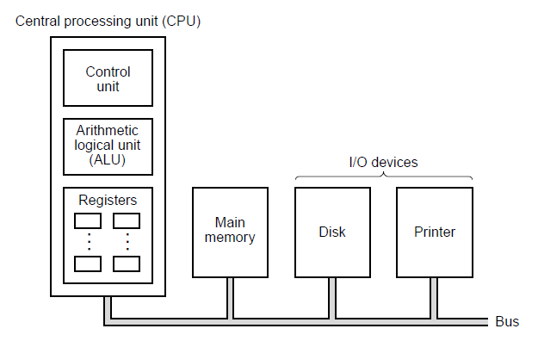
Learning Object (Processors)
History of Computer
The organization of a simple computer with one CPU and two I/O devices.
Notes:
register is temp storage for middle outputs and command.

Slide 5
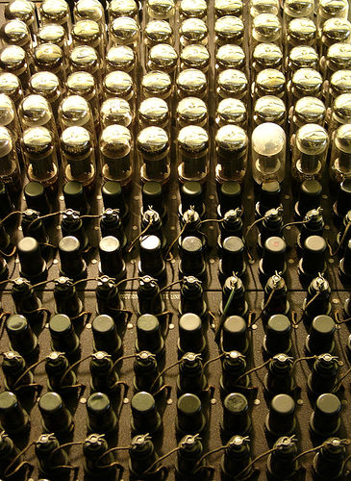
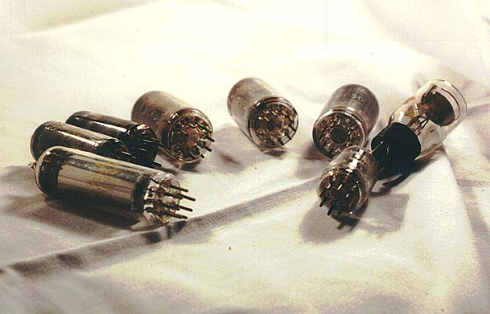
1st Generation Computer
Organization is how features are implemented
Like body
The 1st Generation
Vacuum Tubes
ENIAC (20,000 vacuum tubes)
Decimal (not binary)
Programmed manually by switches
Notes:
7200 crytal diodes
Decimal (not binary)
10 vacuum tubes represented each digit
Only one was on to represent one of 10 numbers
Programmer change the switches and line to make a program.

Slide 6
Stored Program concept
It was tedious to program ENIAC manually
Why not store the commands in the memory and let the computer read them?
Main memory storing programs and data
ALU (Arithmetic and Logic Unit) operating on binary data
Control unit interpreting instructions from memory and executing
Input & output equipment operated by control unit
Notes:
make more components: Main memory, ALU and control Unit
ALU process binary data.

Slide 7
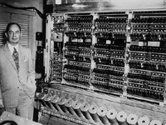

IAS Computer
John von Neumann and colleagues began design of IAS (Institute for Advanced Study) Computer.
Completed in 1952
Mother of all subsequent general purpose computer
Notes:
It is the mother of all subsequent general purpose computer.

Slide 8
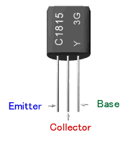
2nd generation
Transistors
Invented 1947 at Bell Labs by William Shockley et al. (Nobel prize in Physics in 1956)
Replaced vacuum tubes
Transistors are
Smaller, Cheaper, Less heat dissipation
Solid State device. No need for wires, metal plates, glass capsule. Made from Silicon (Sand)

Slide 9
3rd Generation
Until early 1960s, computers were composed of discrete components (transistors, resistors, capacitors, etc), manufactured separately.
Transistor → circuit board: expensive
Early 2nd gen: 10,000 transistors.
Later needed 100,000.
How to put them all?
Integrated Circuit
Birth of Microelectronics
Notes:
However, more transistors required for the computer to make better performance.

Slide 10
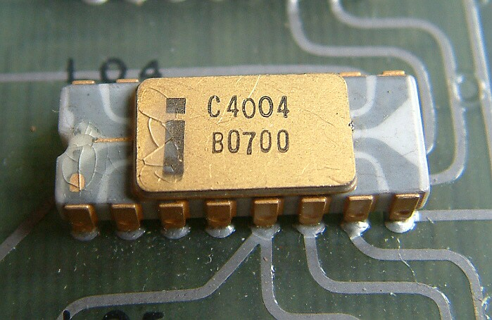
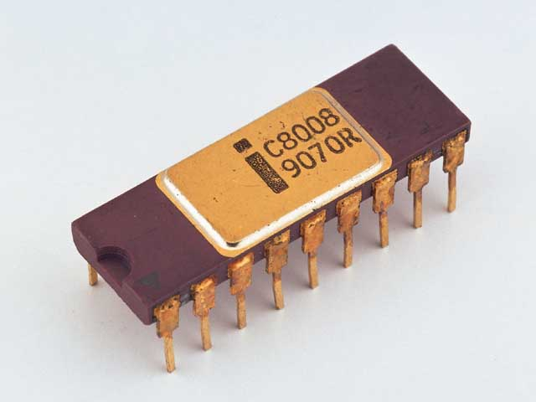
Intel Processors
4-bit Processors
4004, 4040
First microprocessor
All CPU components on a single chip
8-bit Processors
8008,8080,8065
Intel’s 1st general purpose microprocessor
16-bit Processors
8086, 8088, 80186, 80286
80186: Assembly Language compatible
80286: Embedded, 16 Mbyte memory addressable
Notes:
4-bit processor is the first 3rd generation cpu.

Slide 11
War on 64-bit standard
Increase bit for improving Processors
Until 32-bit processor
64-bit processor is not an extension of 32-bit
Completely different
new instructions set from 32-bit processor
Mostly for servers
AMD announced 64 bits architecture (AMD64 or x86-64), 2003
Long mode (extends all IA-32 instructions to 64 bit)
Legacy mode (identical to IA-32)
Compatibility mode (user pg in IA-32, OS in AMD64)
Notes:
However, after 32 bit processor, the 64 bit processor is required new architecture for the processor.
IA-64 is the instruction set architecture (ISA) of the Itanium family of 64-bit Intel microprocessors

Slide 12
War on 64-bit standard
IA-64 is not an extension of IA-32
Completely different
New instructions set from IA-32
Mostly for servers
AMD announced 64 bits architecture (AMD64 or x86-64), 2003
Long mode (extends all IA-32 instructions to 64 bit)
Legacy mode (identical to IA-32)
Compatibility mode (user pg in IA-32, OS in AMD64)
Intel embraces AMD64→ IA-32e (EM64T, and now Intel 64), 2004
Notes:
However, after 32 bit processor, the 64 bit processor is required new architecture for the processor.

Slide 13
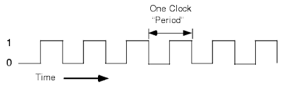
Increasing Speed of Processor
Three Strategies to Improve CPU performance
Increase hardware speed of processor
By shrinking logic gate size
More gates packed more tightly
→ Propagation time for signals reduced
By increasing clock rate
Notes:
We briefly showed the history of computer and CPU

Slide 14
Increasing Speed of Processor
Problems with strategy 1
Power
Power density (Watts/cm²) increases with density of logic and clock speed
Dissipate more heat → The greatest problem now
RC delay (Resistance, Capacitance)
Wire interconnects thinner, increasing resistance
Wires closer together, increasing capacitance
RC product increases → delay increases
Memory latency
Memory speeds lag processor speeds
Better Solution:
More emphasis on organizational and architectural

Slide 15
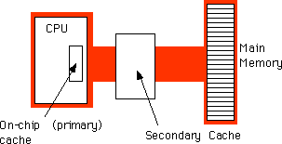
Increasing Speed of Processor
Increase size and speed of caches
And dedicate a part of processor chip
→ cache access times drop significantly
Change processor organization and architecture
Increase effective speed of execution
With some kind of parallelism
Notes:
We briefly showed the history of computer and CPU

Slide 16
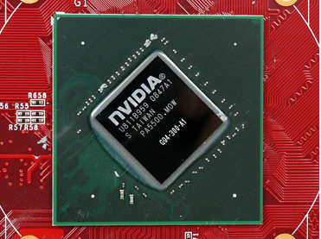
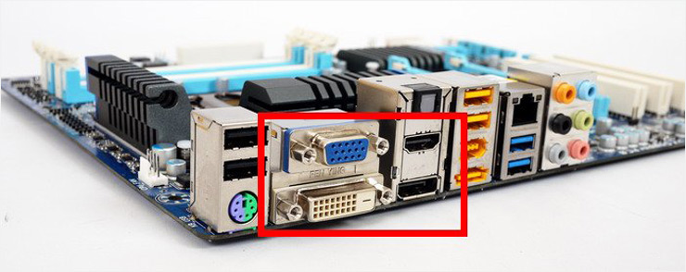
Graphics Processing Unit (GPU)
Perform parallel operations on graphics data
Used to encode and render 2D and 3D graphics as well as process video
Coined by NVIDIA in 1999 (GeForce) – drawing polygon without CPU’s help – good for games!
OpenCL (Standard = Intel, AMD…), CUDA (Nvidia)
Ideal for deep learning, AI, autonomous cars
Notes:
Designed to perform parallel operations on graphics data
Traditionally found on a plug-in graphics card, used to encode and render 2D and 3D graphics as well as process video
Coined by NVIDIA in 1999 (GeForce) – drawing polygon without CPU’s help – good for games!
General Purpose Computing on GPU (GPGPU)
Broad ranges of applications are supported (> CPU, ~2005)
OpenCL (Standard = Intel, AMD…), CUDA (Nvidia)
Ideal for deep learning, AI, autonomous cars

Slide 17
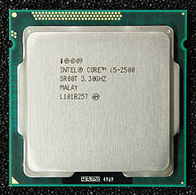
CPU + GPU = APU
Accelerated Processor Unit (by AMD) (2010)
Using the same bus
Lower cost, lower power consumption
Mediocre performance, low market share → Big failure → caused the demise of AMD
Later adopted by video game machines by Sony (Playstation 4) and MS (Xbox 1) (2013)
Intel HD Graphics
Sandy Bridge (2011)

Slide 18
Summary
Modern Computer
Main memory storing programs and data
ALU (Arithmetic and Logic Unit) operating on binary data
Control unit interpreting instructions from memory and executing
Input & output equipment operated by control unit
Increase CPU performance
Increase hardware speed of processor
Increase size and speed of caches
Change processor organization and architecture

